Slide 1
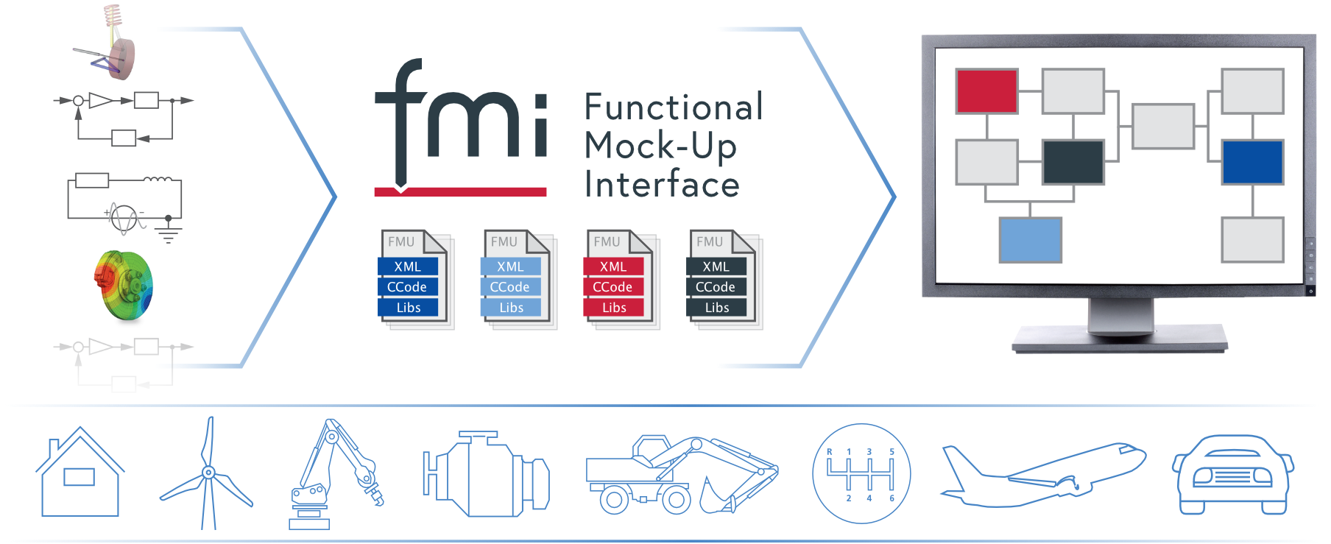
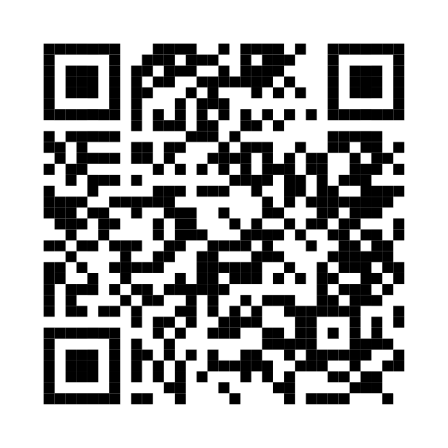
FMI Applications
and Its Role in Digital Twins
Presenters:
Cinzia Bernardeschi, University of Pisa
Maurizio Palmieri, University of Pisa
Claudio Gomes, Aarhus University
Online Materials:
https://github.com/modelica/fmi-beginners-tutorial-2023/tree/main

Slide 2
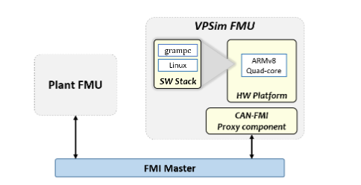
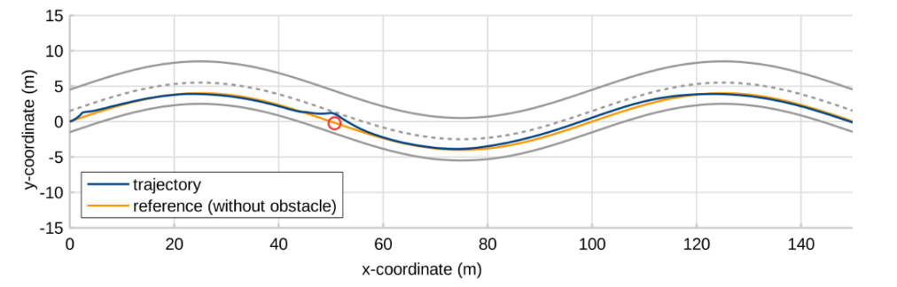



Autonomous Driving Advanced System (SW/HW co-simulation)
Model Predictive Control simulation on selected Hardware platform
Objective:
Validating the controller and assessing the adequacy of the hardware platform with respect to timing constraints and its performance
- GRAMPC
- VPSim - Armv8 Quad-core 64-bit
- Simulink
FMI role: easy validation of deployment of GRAMPC on a simulated architecture
C. Bernardeschi, P. Dini, et al. , Co-simulation of a Model Predictive Control System for Automotive Applications, SEFM 2021 Collocated Workshops, https://link.springer.com/chapter/10.1007/978-3-031-12429-7_15
http://www.european-processor-initiative.eu/ H2020, Grant Agreement No26647
CEA, List, France

Slide 3
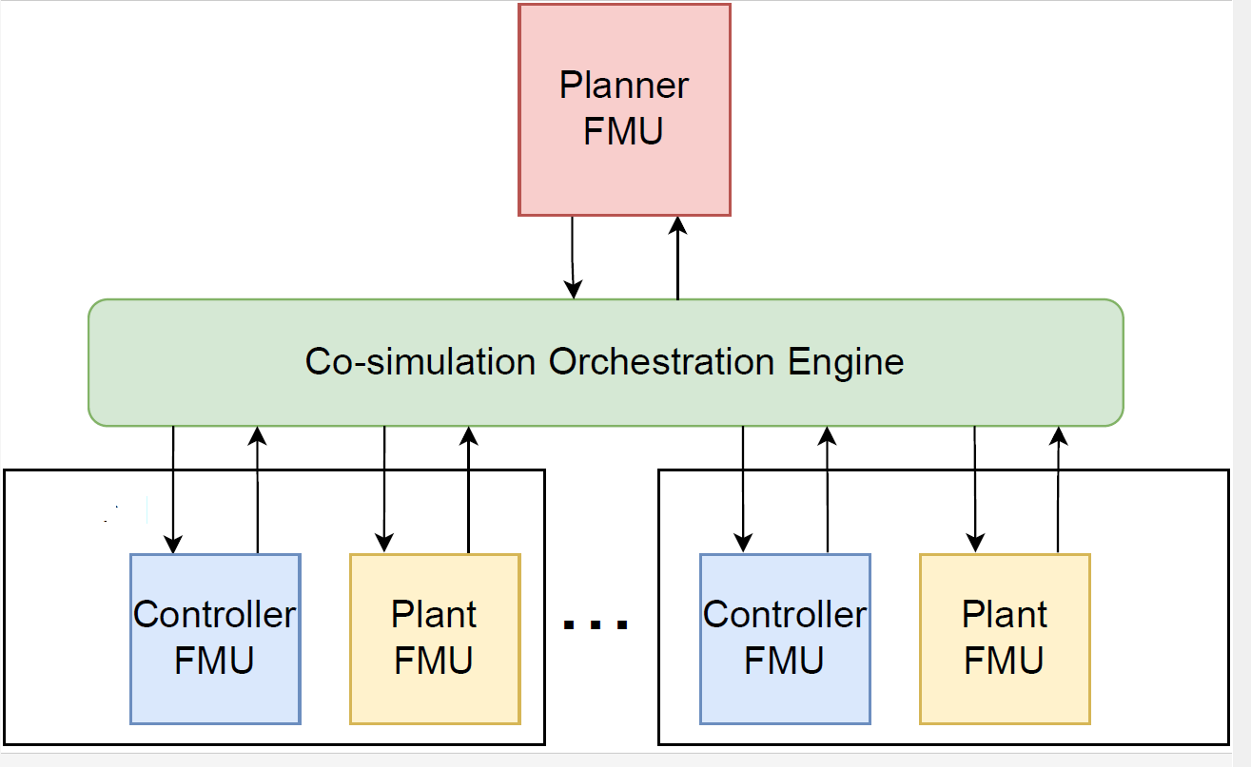
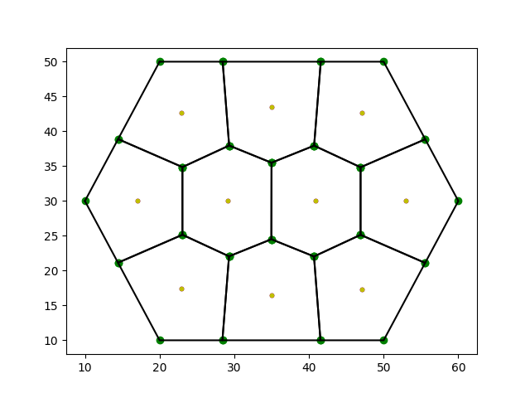
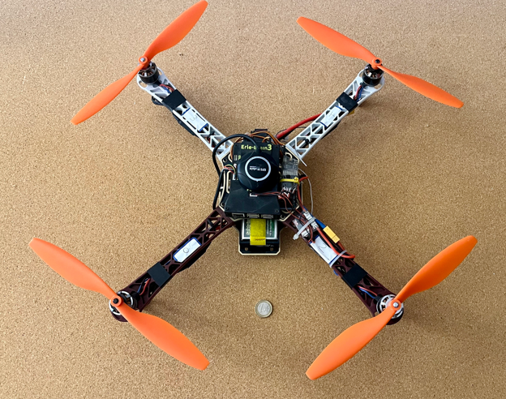

Multi-agent systems: aerial, land vehicles
Multi-UAV system: Planning & Control Objective:
Controller parameters (attitude and position control) calibration for stability in co-operative systems; optimality of values with respect to time to convergence and energy consumption
- Planning algorithm (logic language, python)
- Controller (C)
- Plant (Modelica)
FMI role:
Analysis of the relation between the numeric integration step (co-simulation step) and time discretization interval for planning for stability; analysis of optimality of control parameters value
- https://github.com/INTO-CPS-Association/example-linear-quadcopter - C. Bernardeschi, A. Domenici, et al., Co-simulation and Formal Verification of Co-operative Drone Control With Logic-Based Specifications The Computer Journal, vol. 66, Issue 2, 2023, https://doi.org/10.1093/comjnl/bxab161
Voronoi tesselletion
Erle-robotics quadcopter

Slide 4
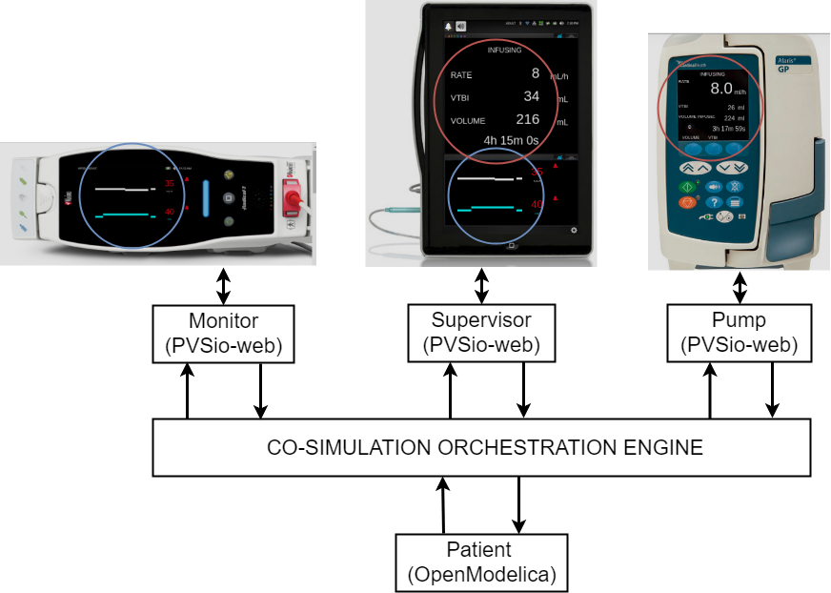
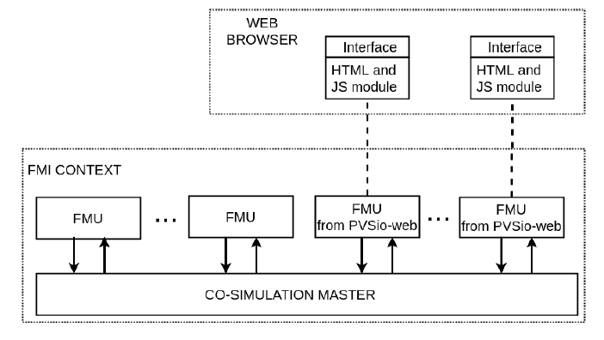


Human-centered systems
Integrated Clinical Environment (ICE)
User interaction with the realistic interfaces of the devices Easy testing and validation of device interaction from different manufactures (use error)
Devices: PVSioweb
Patient: OpenModelica
FMI role:
Validate ICE with respect to patient model. Formal proof of a use-related safety requirement of a device used in the co-simulation
M. Palmieri, C. Bernardeschi, P. Masci. A framework for FMI-based co-simulation of human–machine interfaces, Software and Systems Modeling, vol. 19, Issue 3, 2020, https://dl.acm.org/doi/abs/10.1007/s10270-019-00754-9

Slide 5


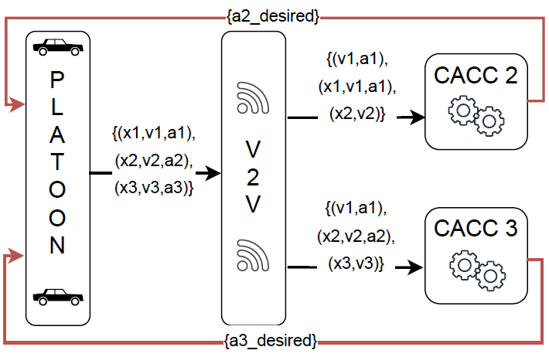
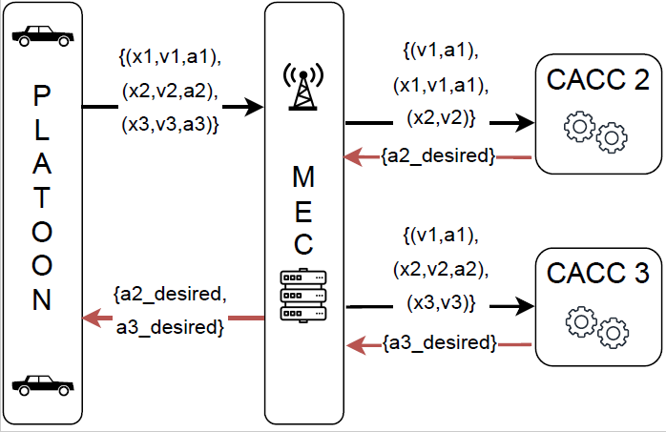
Communications in connected vehicles
Platoon of land vehicles
V2V communication against centralized multi-access edge computing. Performance with vehicle dynamics and different road surface conditions. Strategies to drive safely a platoon in critical road conditions.
3-vehicles
platoon
FMI role: swap from one network architecture to another; analysis of unsafe conditions
M. Palmieri, C. Quadri, et.al, Co-simulated Digital Twin on the Network Edge: the case of platooning, IEEE International Symposium on a World of Wireless, Mobile and Multimedia Networks, 2022, doi:10.1109/WoWMoM54355.2022.00096.

Slide 6
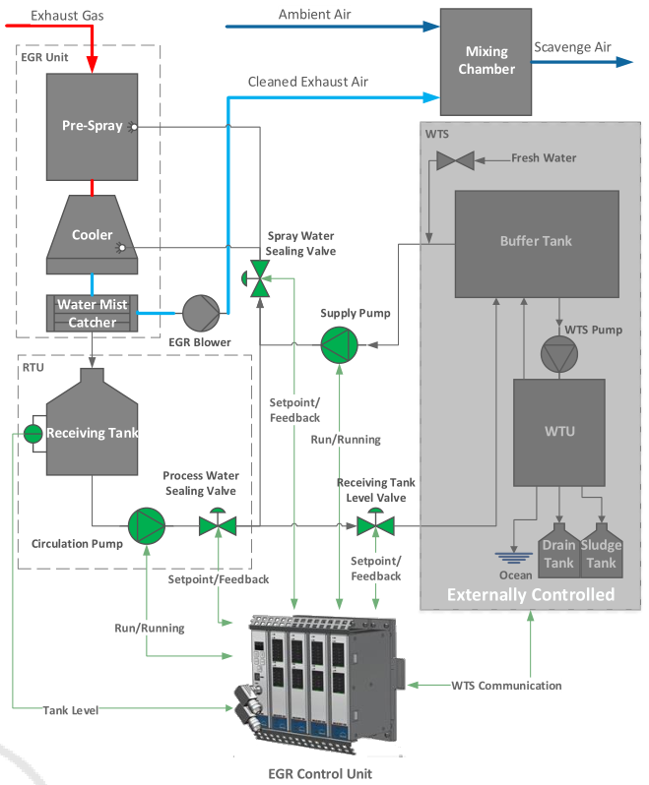
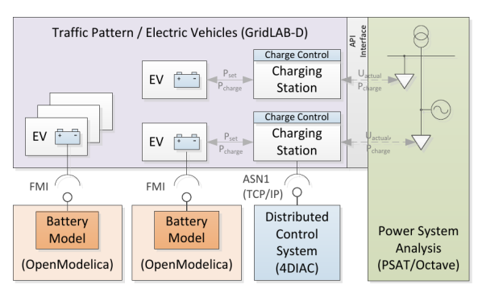
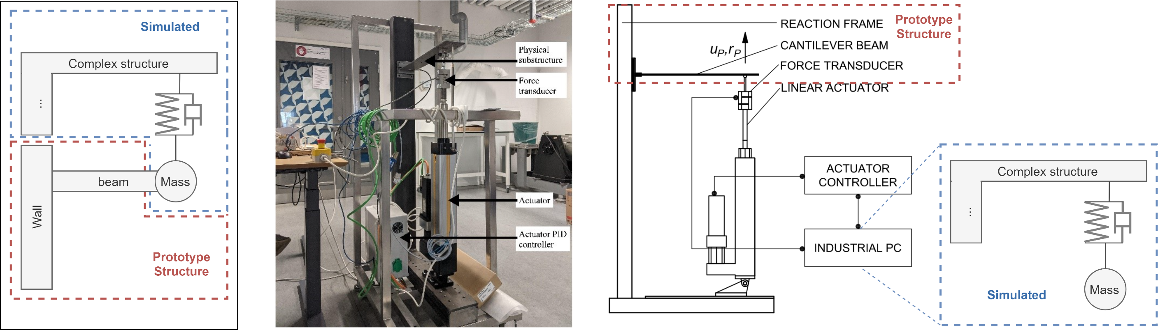
Other applications
Pedersen, N., Lausdahl, et. al (2017). Distributed Co-Simulation of Embedded Control Software with Exhaust Gas Recirculation Water Handling System using INTO-CPS. In 7th International Conference on Simulation and Modeling Methodologies, Technologies and Applications (pp. 73–82).
P. Palensky, E. Widl, M. Stifter and A. Elsheikh, "Modeling Intelligent Energy Systems: Co-Simulation Platform for Validating Flexible-Demand EV Charging Management," in IEEE Transactions on Smart Grid, vol. 4, no. 4, pp. 1939-1947, Dec. 2013, doi: 10.1109/TSG.2013.2258050.
Gomes, Cláudio, Giuseppe Abbiati, and Peter Gorm Larsen. “Seismic Hybrid Testing Using FMI-Based Co-Simulation.” In Proceedings of the 14th International Modelica Conference. online: Linköping University Electronic Press, Linköpings Universitet, 2021. https://doi.org/10.3384/ecp21181287.

Slide 7
FMI & Digital Twins

Slide 8
Definition in this Tutorial: Digital Shadow
Physical Twin (CPS)
Digital Shadow
Plant
Communication
Visualization
Monitoring
Predictive maintenance
Fault Diagnosis
Support for decision making
Env
Controller

Slide 9
Digital Twin Definition in this Tutorial
Physical Twin (CPS)
Digital Twin
Plant
Visualization
Monitoring
Predictive maintenance
Fault Diagnosis
Support for decision making
Re-configuration of PT
Communication
Env
Controller

Slide 10
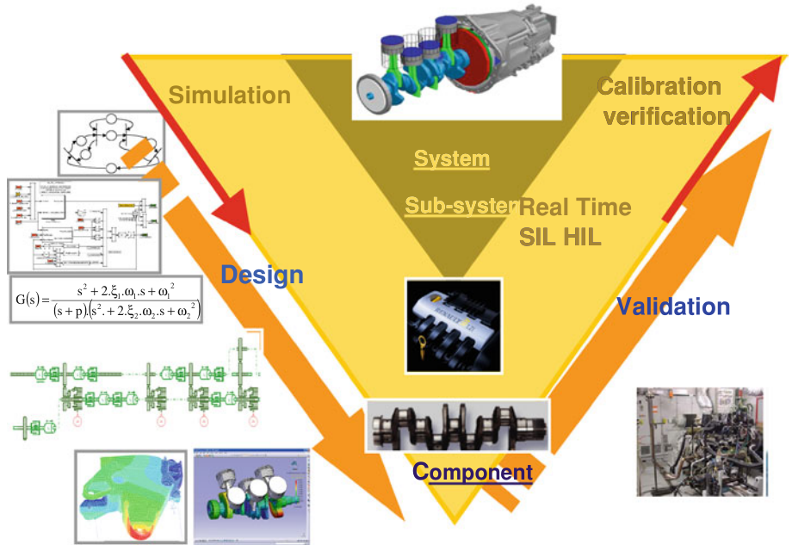
Opportunities of FMI in DTs
Physical Twin
Leverage design time models at deployment time.
Digital Twin
Deploy models without design time tooling.
Development
Deployment

Slide 11
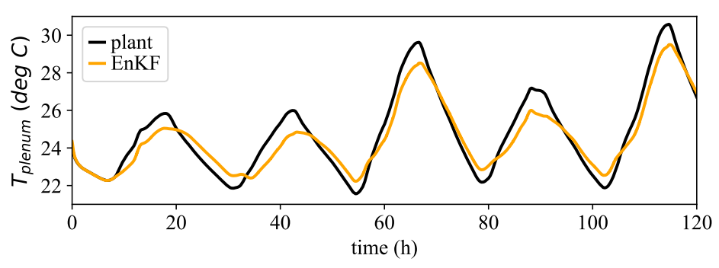
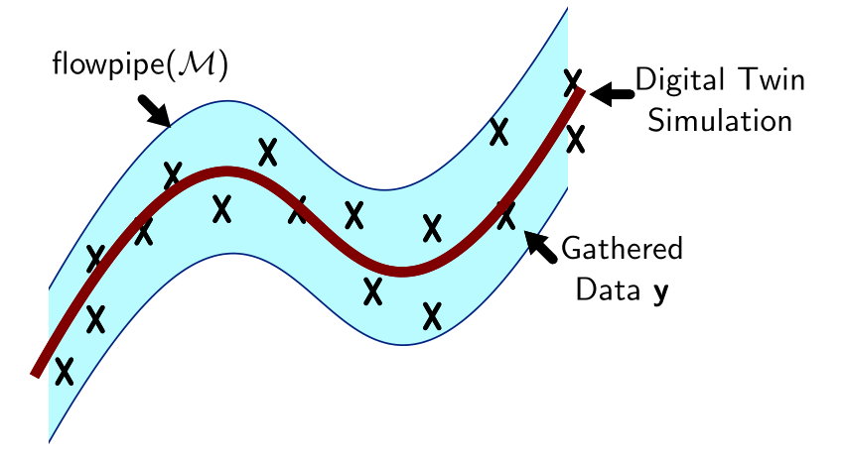
Role of FMI in Digital Twinning
Laughman, Christopher, and Scott A Bortoff. “Nonlinear State Estimation with FMI: Tutorial and Applications,” 23–25, 2020.
Digital Twin
Legaard, Christian Møldrup, Cláudio Gomes, Peter Gorm Larsen, and Frederik F. Foldager. “Rapid Prototyping of Self-Adaptive-Systems Using Python Functional Mockup Units.” In Proceedings of the 2020 Summer Simulation Conference, 1–12. SummerSim ’20. Virtual Event. https://doi.org/10.5555/3427510.3427532.
Visualization
Monitoring
Predictive maintenance
Fault Diagnosis
Support for decision making
Re-configuration
Communication
Models
Bogomolov, Sergiy, Cláudio Gomes, Carlos Isasa, Sadegh Soudjani, Paulius Stankaitis, and Thomas Wright. “Reachability Analysis of FMI Models Using Data-Driven Dynamic Sensitivity.” SIMULATION, Special Issue: Engineering of Dependable Digital Twins, 2023, accepted.

Slide 12
Wrap up

Slide 13
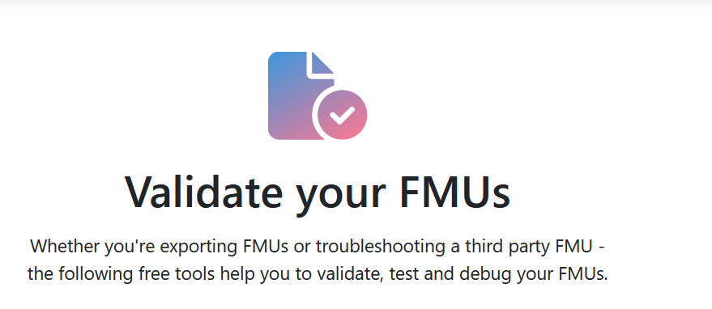


Resources
FMI Webpage
FMI tools list
FMU validation
Publications
Reference FMUs
A set of hand-coded FMUs for development, testing and debugging of FMI.
In case of questions we recommend to use StackOverflow with tag „fmi“
You are welcome to join the (unofficial) FMI LinkedIn Group

Slide 14
Thank you!
Any questions or comments?
Presenter Contacts
Christian.Bertsch Christian.Bertsch@de.bosch.com, contact@fmi-standard.org
Maurizio Palmieri maurizio.palmieri@ing.unipi.it
Cláudio Gomes claudio.gomes@ece.au.dk

